Slide 1

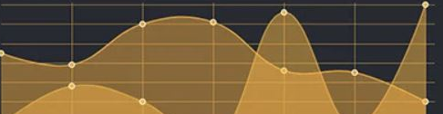


WEB APP SOLUTION FOR
KPI MANAGEMENT
04 November 2023
deploy(impact) program

Slide 2

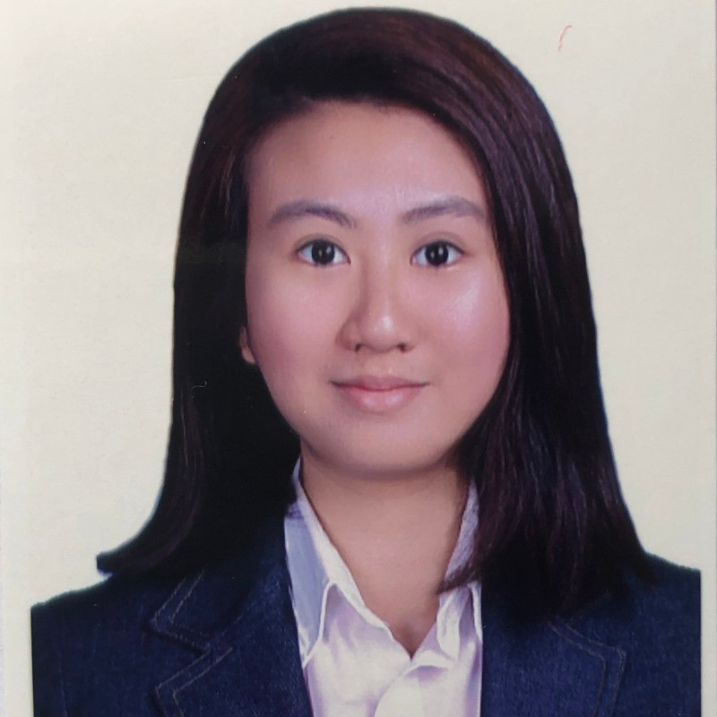
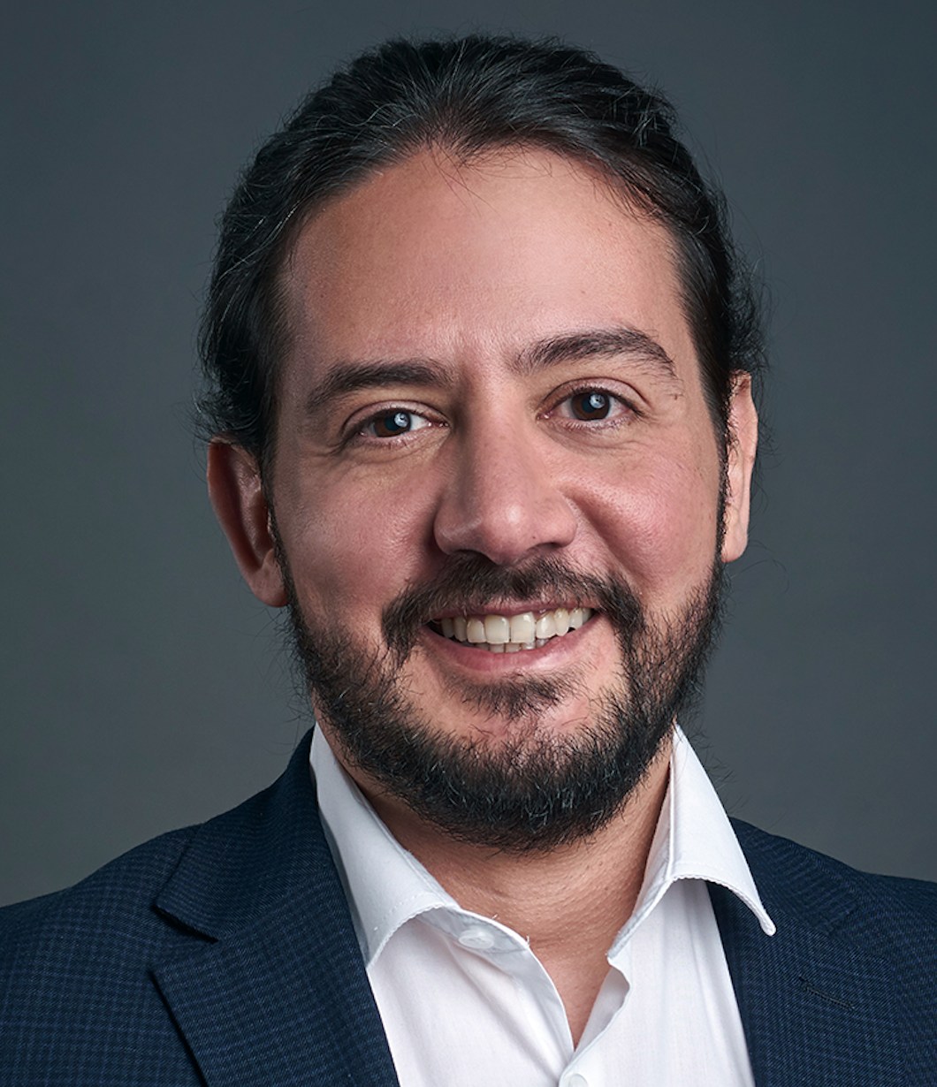
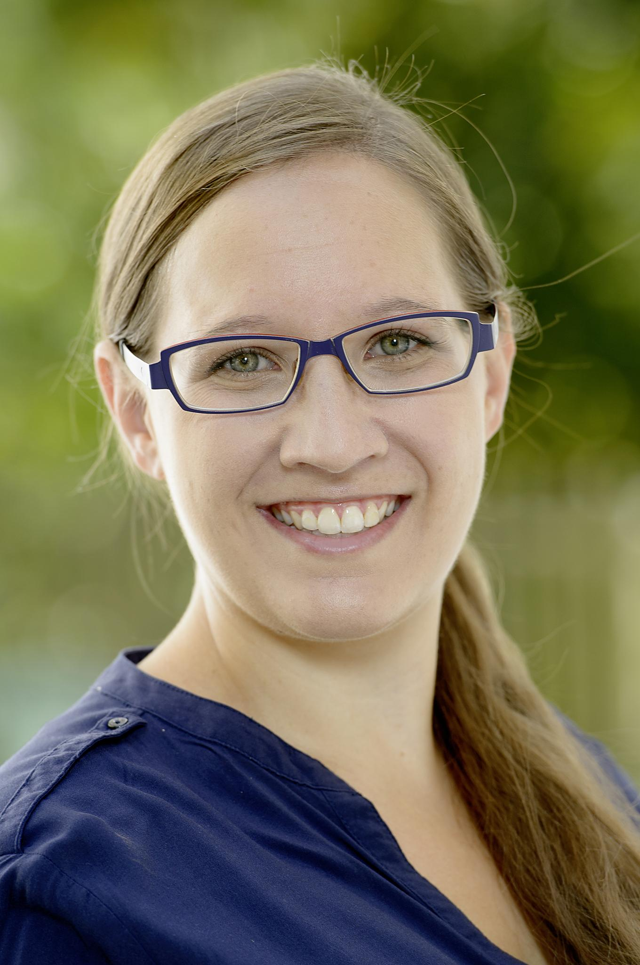


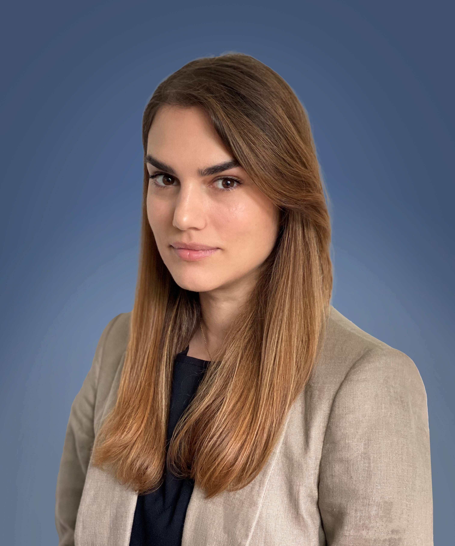

KPI 5 Team
Delfim Almeida
Frontend
Karin Sim
Data Scientist
Raphael Cordon
Backend
Petra Brunner
PM
Kyrian Uzoagba
UX&UI
Salomea Shengelia
UX&UI
Mihaela Brankova
Team Satellite
deploy(impact) program

Slide 3
Problem
Pro Juventute has a large variety of activities and programs
Collecting KPIs from diverse audiences
Some KPIs are collected automatically and others, manually
The reports are not standardized
The daily basis management of the reports is complex
Lacking visibility due to the differences between reports
deploy(impact) program

Slide 4
How we intend to solve
Building a Web Application as a single data entry point:
REPORTS can be added, updated and visualized (CRUD)
KPIs can be set and adjusted as needed
INTEGRATION with external tools, in a managed and secure way
A modular and modern App
A user-driven solution
Must be easy to use, maintain, update and scale
deploy(impact) program

Slide 5




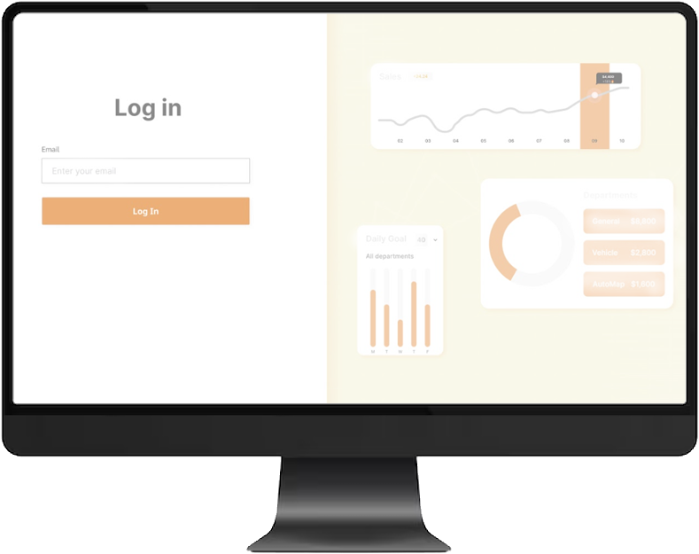
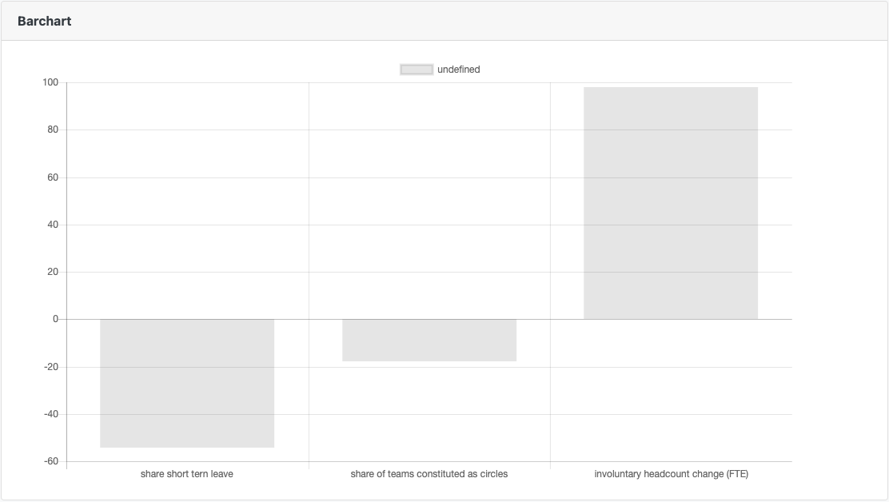
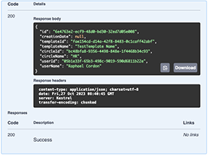
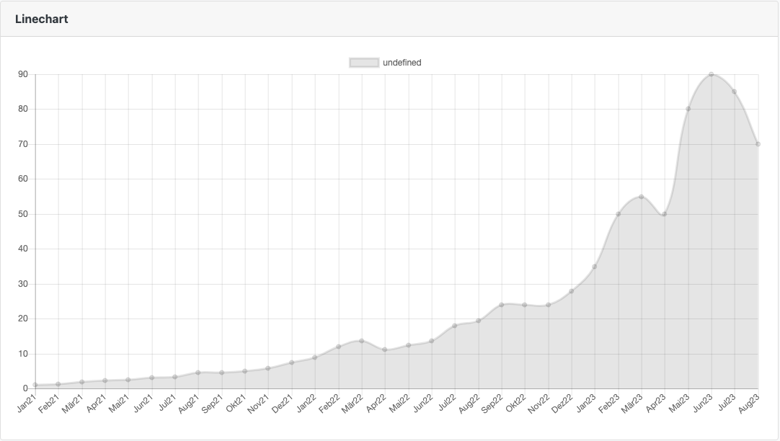
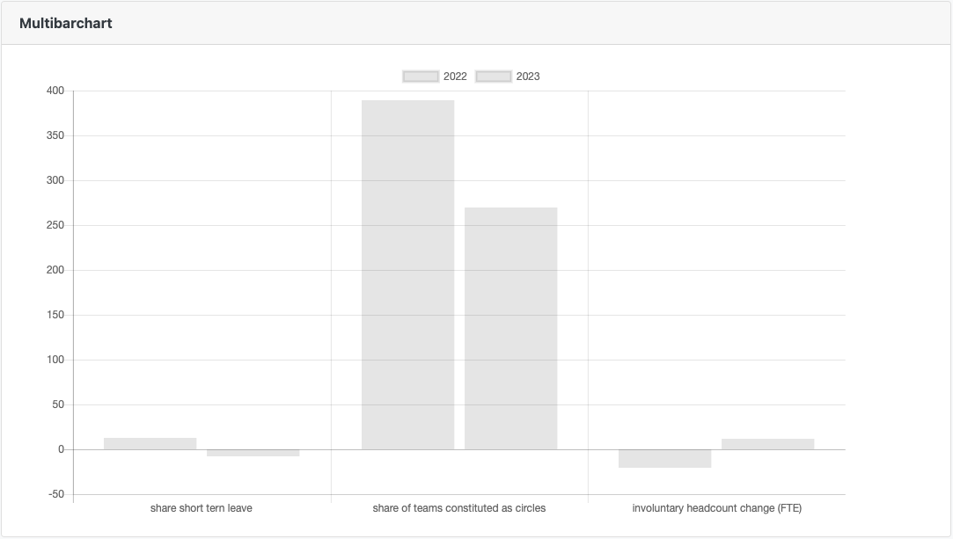




Web App structure
Modular structure
BACK END
FRONT END
API for building
Graphics
API for external
access to Data
Database and Authentication

Slide 6
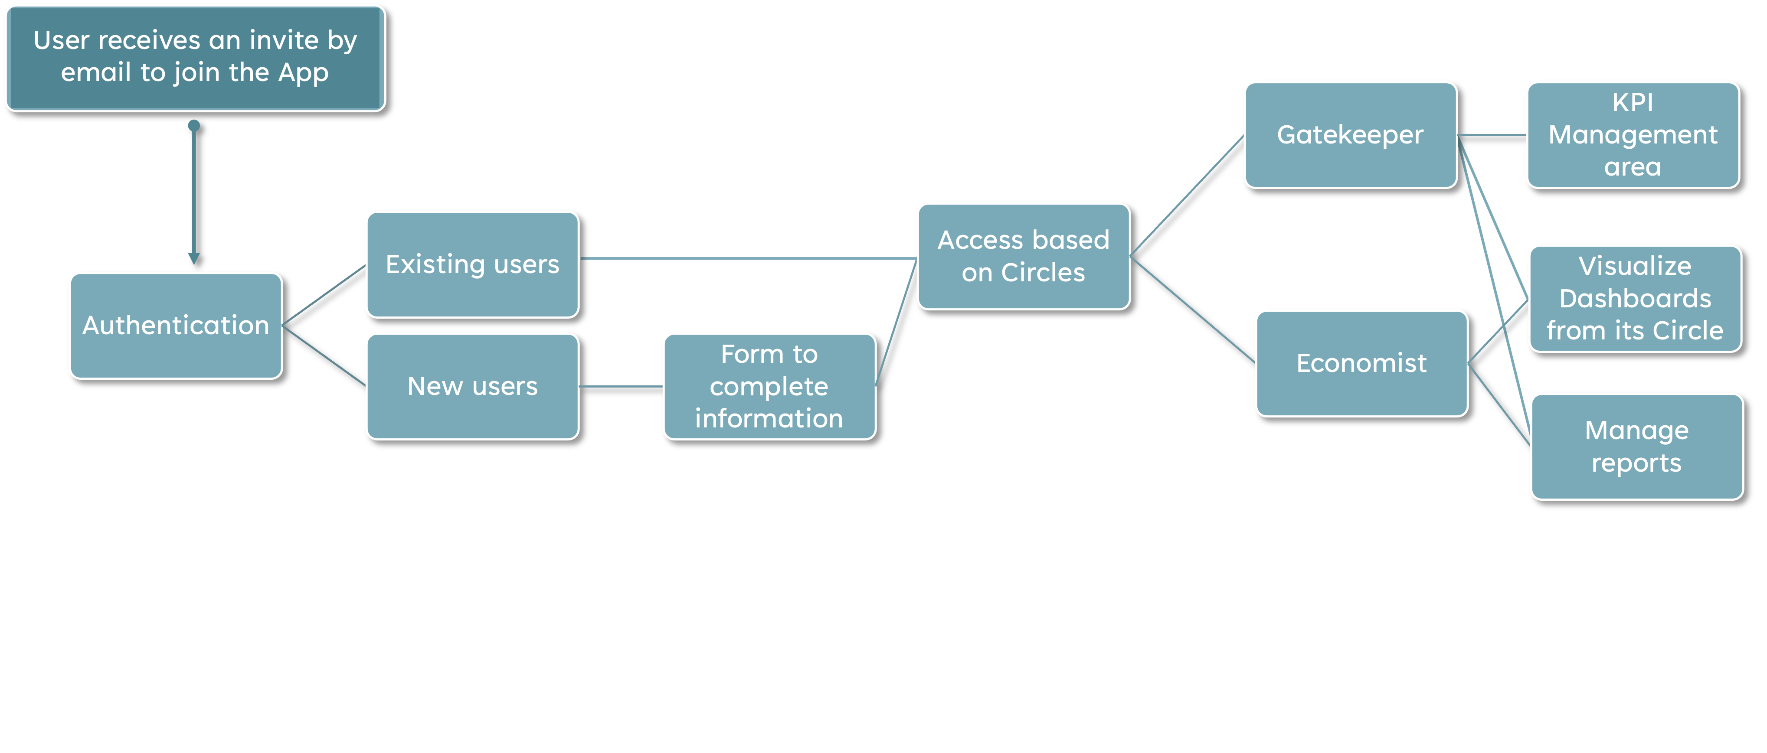
Web App – User’s journey
The MVP aims to cover the happy path, variations of the scenario above to be included in future releases

Slide 7
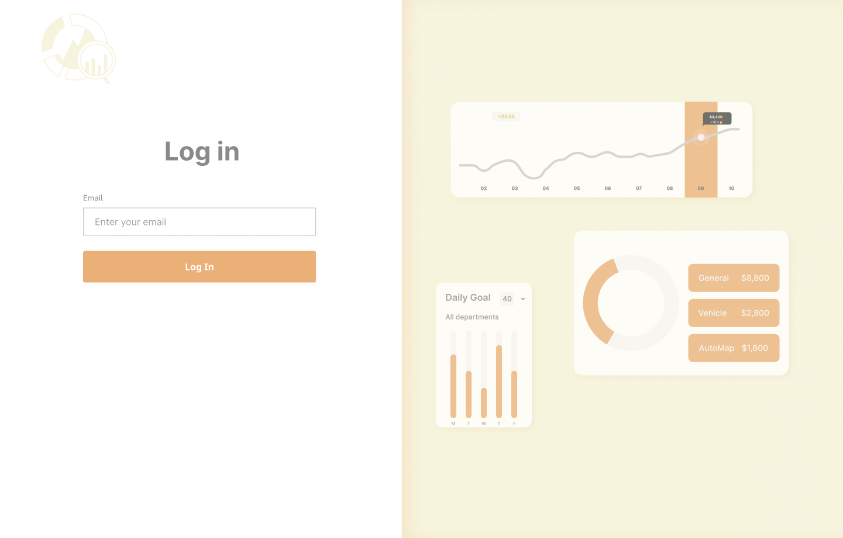
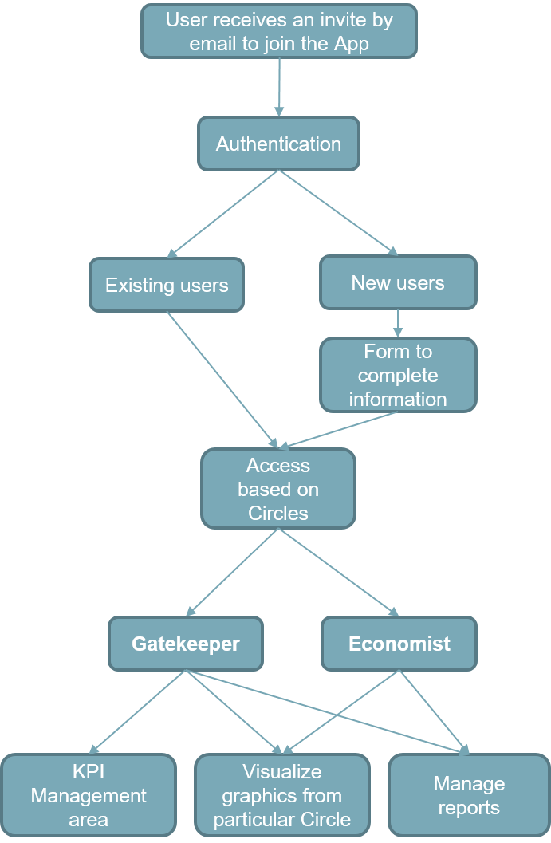
Web App – Authentication

Slide 8
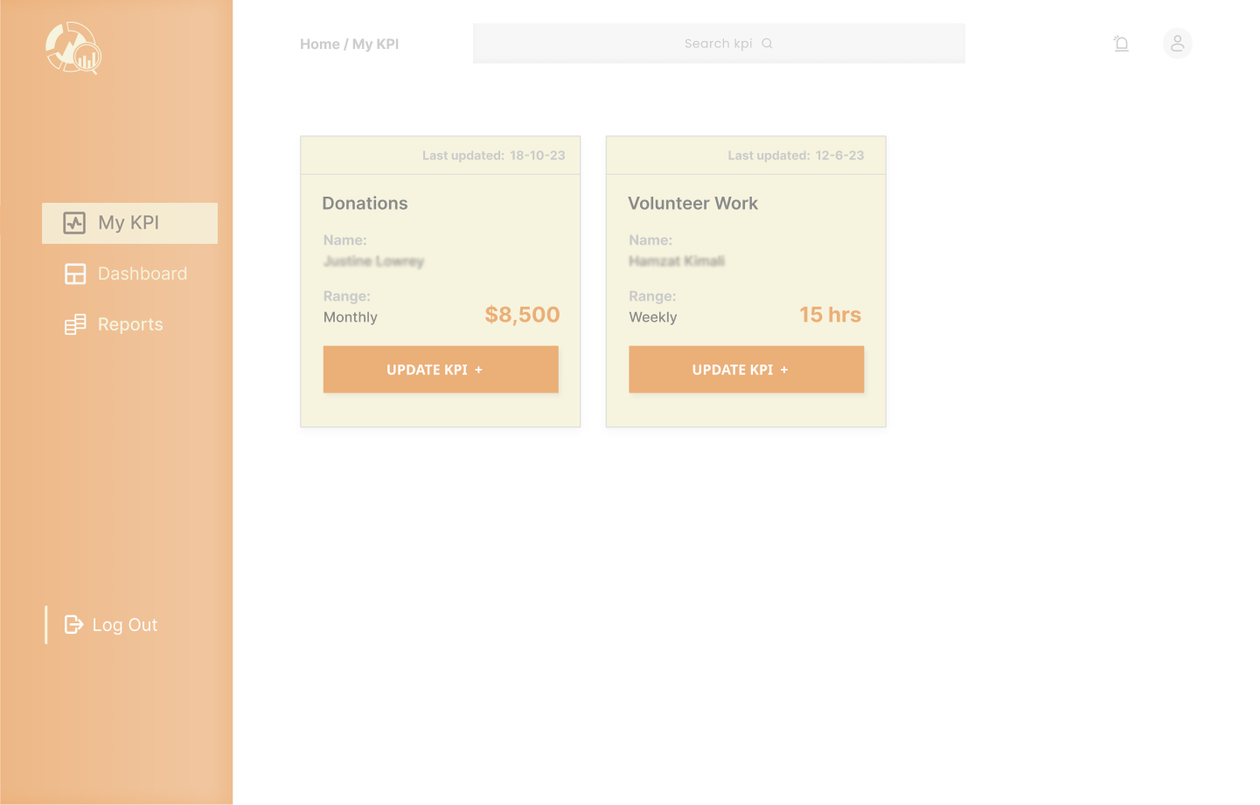
Web App – KPIs

Slide 9
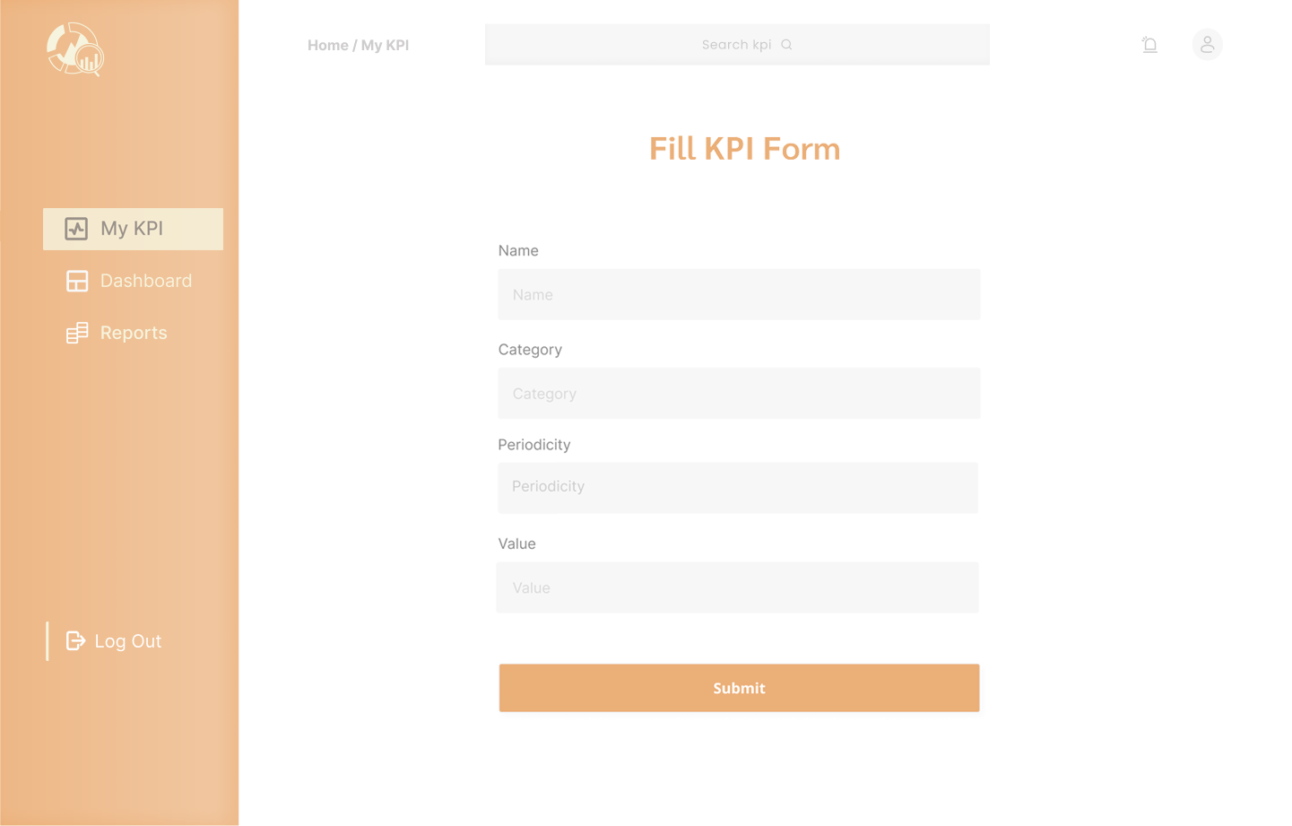
Web App – KPIs

Slide 10
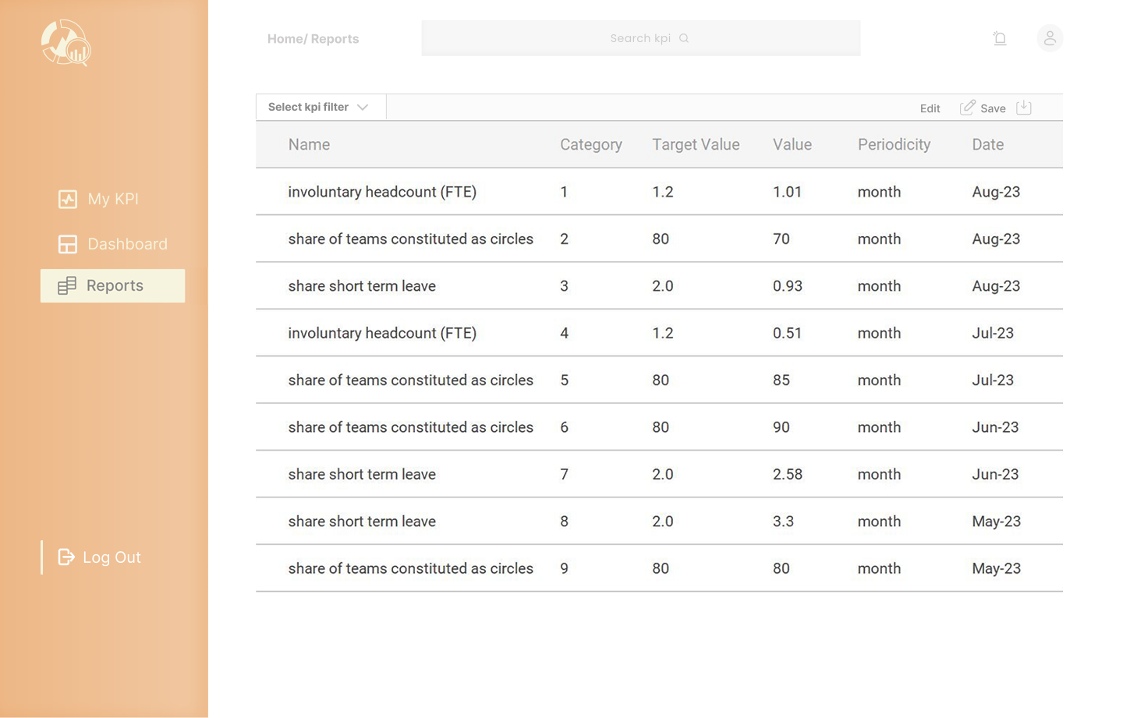
Web App – Reports

Slide 11
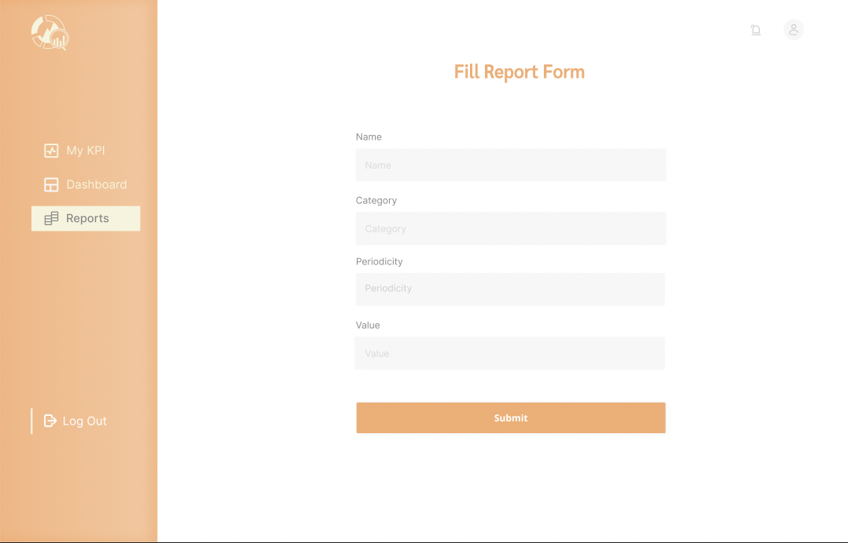
Web App – Reports

Slide 12
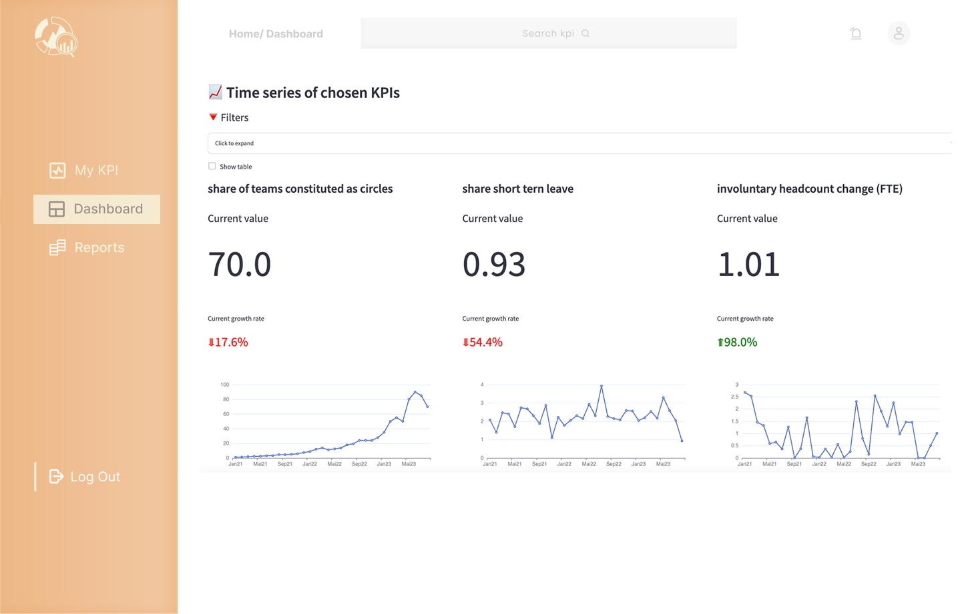
Web App – Dashboards

Slide 13
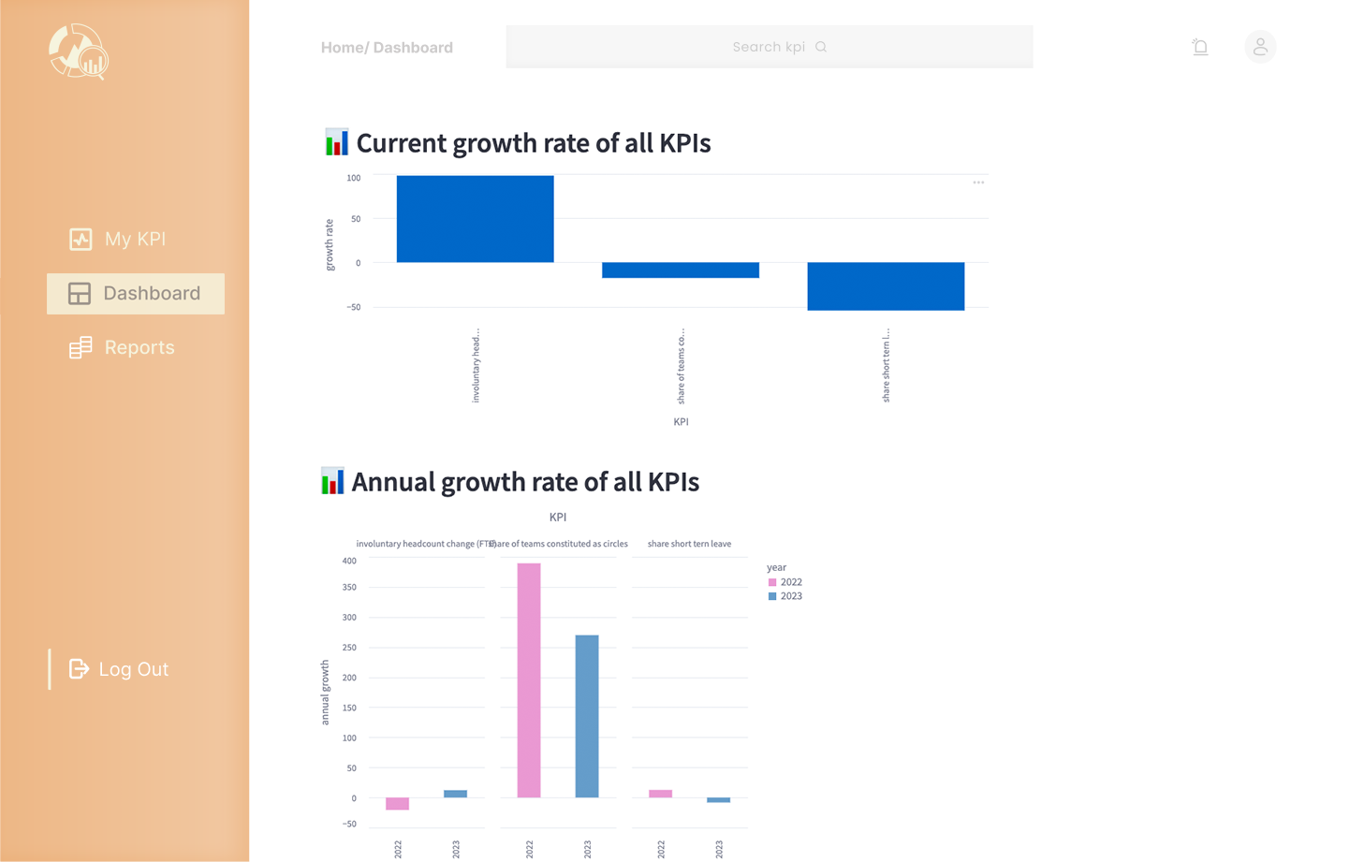
Web App – Dashboards

Slide 14
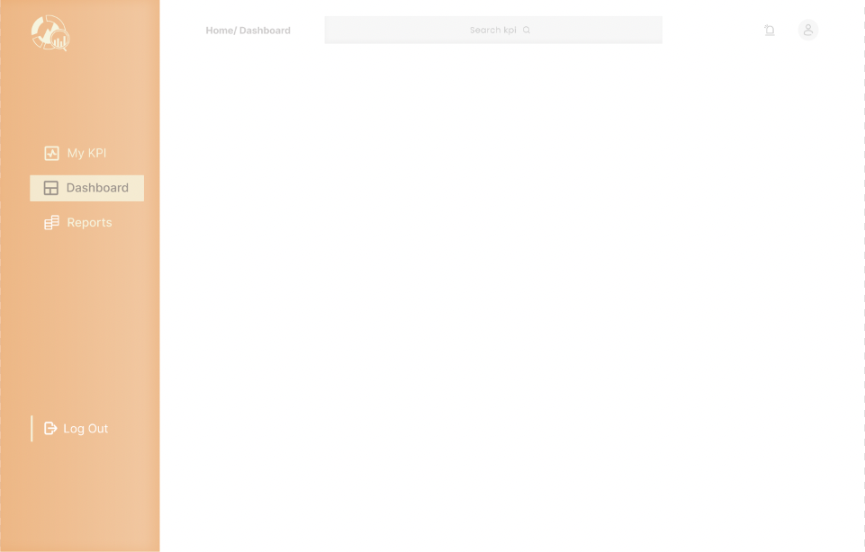
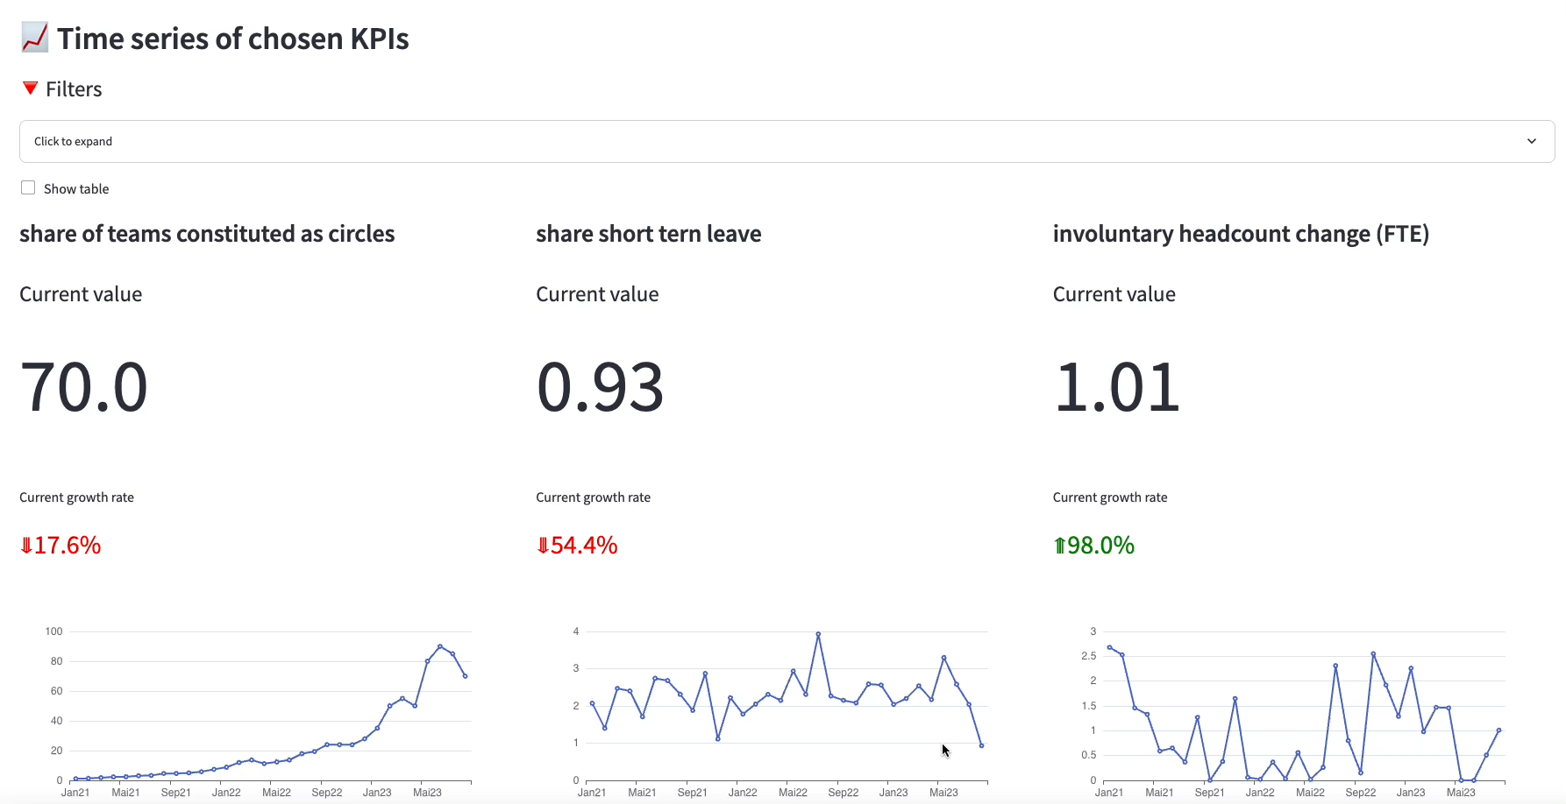
Web App – Dashboards

Slide 15

Learned Lessons
Technical
Integration between frontend/backend
Independent modules providing standardized data (RESTful APIs)
Parallelized technical activities, improving performance
Add value to the backend using Supabase
Building a Read-only API, protecting data without restricting the access
deploy(impact) program

Slide 16

Learned Lessons
Team working
- Team member losses: One replacement and two losses
United the team, communication was KEY
The project was redesigned to fit the new size, focusing on each one’s expertise
Stressful moments:
Scope (re)definition, team re-sizing and technical blockers
We agreed upon an MVP
Spoke and listened openly
Learned new skills to conclude the project
deploy(impact) program

Slide 17


KPI 5 Team
Petra Brunner
brennwaldpetra@gmail.com
linkedin.com/in/petra-brunner
Delfim Almeida
dealmeida.dev@gmail.com
github.com/dealmeida-dev
Raphael Cordon
cordon@outlook.com
linkedin.com/in/raphael-cordon
github.com/raphaelcordon
Mihaela Brankova Team Satellite
Kyrian Uzoagba
jaodesigns00@gmail.com
github.com/jaodx0
Karin Sim
karinsim25@gmail.com
linkedin.com/in/karin-nakanishi-577967272
github.com/karinsim
Salomea Shengelia
salomeashengelia18@gmail.com
github.com/Sallyshengelia
Mihaela Brankova
mi.brankova@gmail.com
linkedin.com/in/mihaela-brankova
deploy(impact) program

